Slide 1
SMART CARD FOR SMART CITY PEOPLE :CREDIT CARD CUSTOMERS PREDICTION
GUIDED BY
DR.M.P.SIVARAM KUMAR ME.,P.HD
DONE BY
JOHNSON SAJJIN RAJ.N (210214205004)
NIVESH S.K (210214205007)

Slide 2
ABSTRACT
The government try to all the people details digitalized.
Because when digitalized people information get anywhere in the world.
India doing many project for digital india.
If the smart city how the people information maintains by the government and how use the smart card information in different application.
We did the project for use of bank, use of medical information in the smart cities.

Slide 3
LITERATURE REVIEW
HUMAN HEART DISEASE PREDICTION SYSTEM USING DATA MINING TECHNIQUES
AUTHOR:Theresa Prince. R , J. Thomas
PUBLISHED ON:2016.
DESCRIPTION:
Each individual has different values for Blood pressure, cholesterol and pulse rate. But according to medically proven results the normal values of Blood pressure is 120/90, cholesterol is and pulse rate is 72.
click

Slide 4
LITERATURE REVIEW
Credit Card Fraud Detection Based on Transaction Behaviour
AUTHOR:John Richard D. Kho, Larry A. Vea.
PUBLISHED ON:2017.
DESCRIPTION:
This paper is suggesting that a detection model must be available to capture the possible transactions – a fall back in case the technology will fail.

Slide 5
EXISTING SYSTEM
The existing system for the credit card system collect the bank statement and the agent gives certificate to the eligible people.
If the new patient admit in the hospital doctor don’t knew about the patient result may be do the wrong treatment
Disadvantage
The agent may be doing some fraud to get the money from the ineligible people.
Patient may be die because of wrong treatment

Slide 6
PROPOSING SYSTEM
Link the all bank account in single account that useful to identify the status of the people.
That also useful to government for identify the low level people and providing good service to them.
The credit card agencies can only access some of information about customers like bank deposit, loan pending , monthly reports.
The credit card system identify the eligible customers by the condition

Slide 7
PROPOSING SYSTEM(COND.)
In the hospital system the people all the treatment and the report and the prescription and the payment are update
That useful for the doctor do the treatment by the previously medical checkup information
That useful to do the right treatment by doctor for new patient.

Slide 8
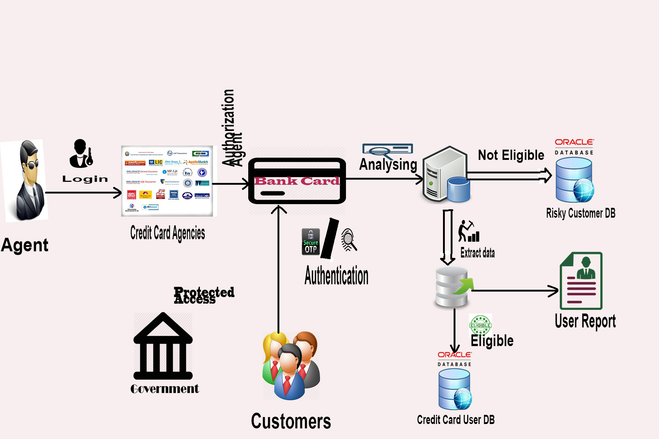
SYSTEM ARCHITECTURE

Slide 9
REQUIREMENT
HARDWARE REQUIREMENT
PROCCESSOR 2.0GHz and above.
RAM 2GB and above.
MEMORY 160GB and above.
SOFTWARE REQUIREMENT
PLATFORM Windows 7and above
PACKAGE JDK 1.7 and above, eclipse mars, heidiSQL, Apache tomcat
LANGUAGES Advance Java, HTML, CSS, JSP, MySQL, JavaScript

Slide 10
MODULES
B_CARD REGISTRATION
Link all accounts in the single account.
CREDIT CARD USER PREDICTION
Using the card holder’s data predict the customers by data mining prediction techniques.
OTHER SMART CARD INFORMATION UPDATE
update medical, property, gold, family information .

Slide 11
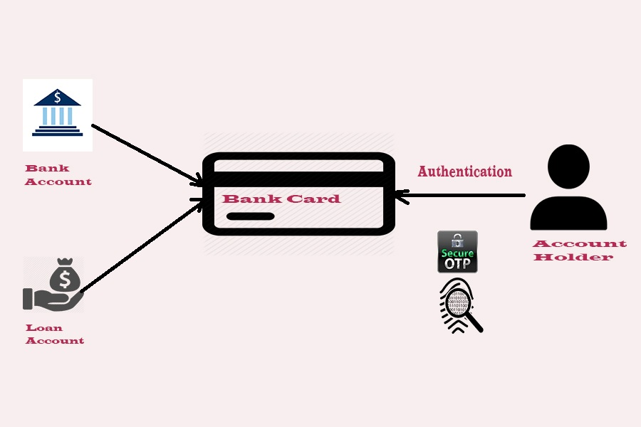
B CARD REGISTRATION
Update all bank and loan account data use the account numbers register the b card the current status of the those account are update and report will be display.

Slide 12
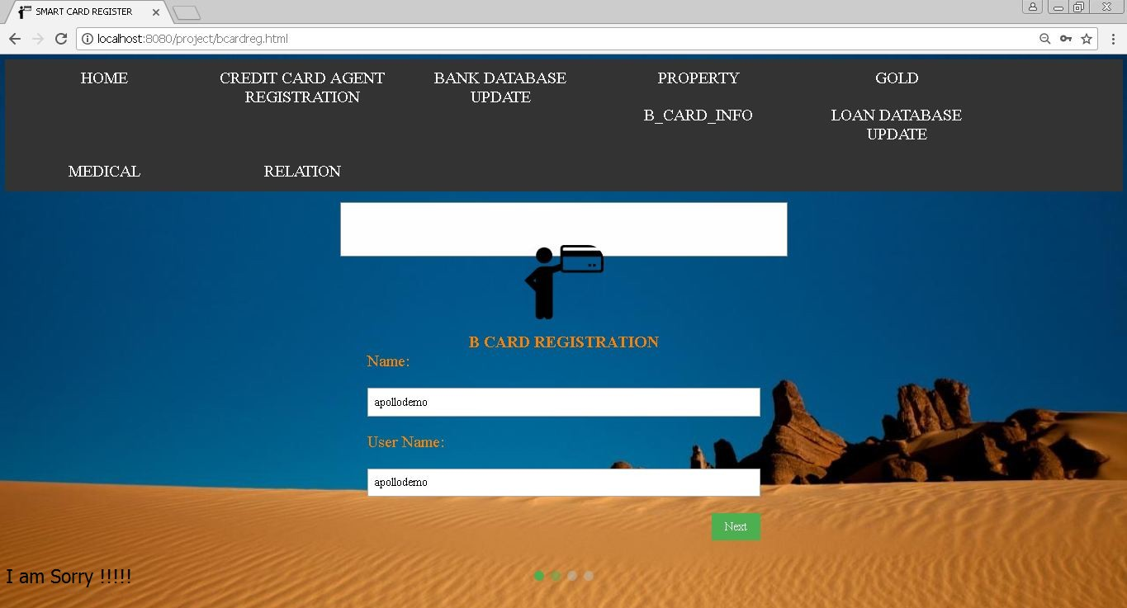
Sample output

Slide 13
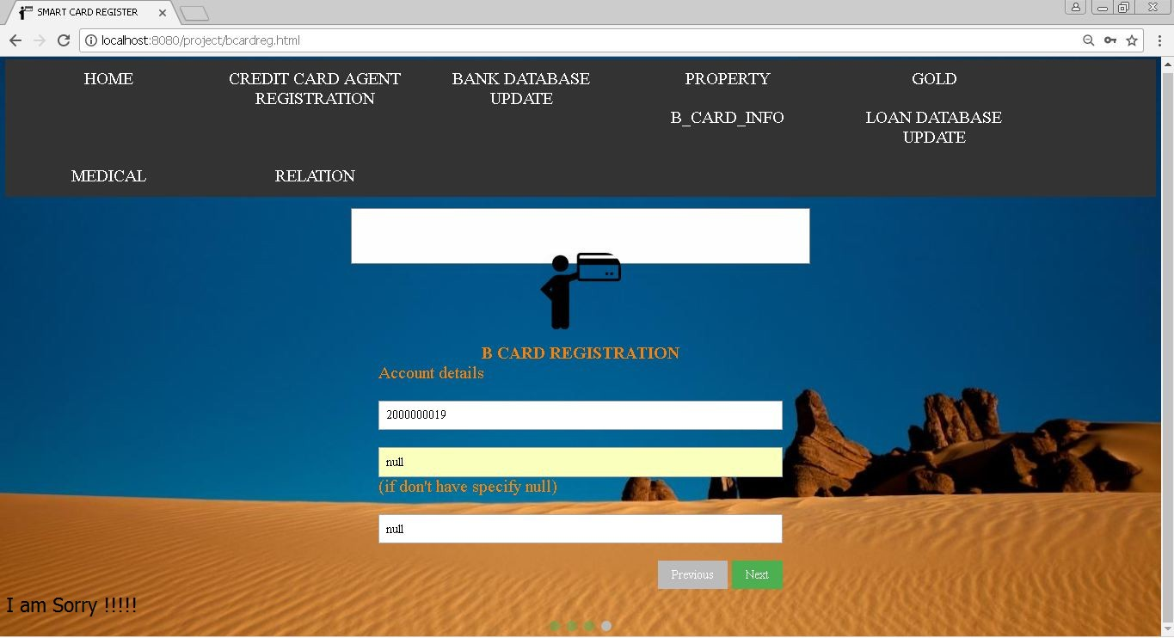

Slide 14
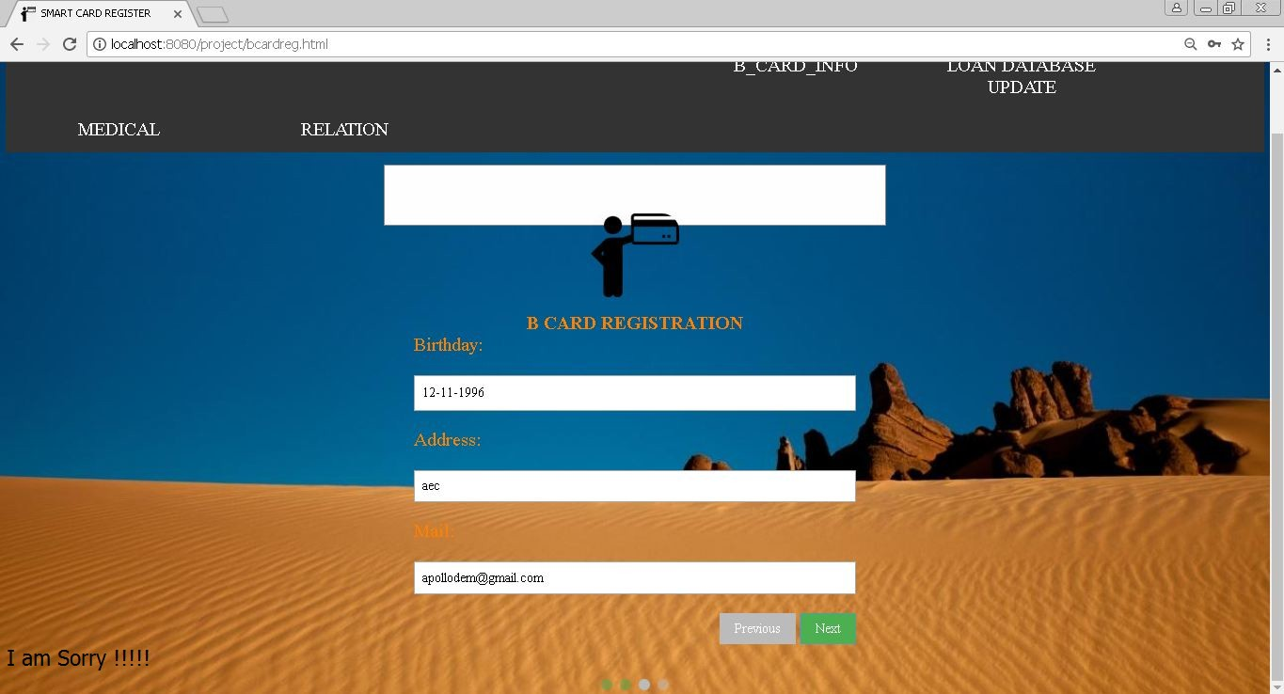

Slide 15
CREDIT CARD USER PREDICTION
Credit card agent login the system and give the b card number and agency pin to login .
eligible b card member are predict by the loan and bank account data .if the member eligible then credit card number will be generate and the data are get by the b card.
Otherwise the store it in a risky customer database.

Slide 16
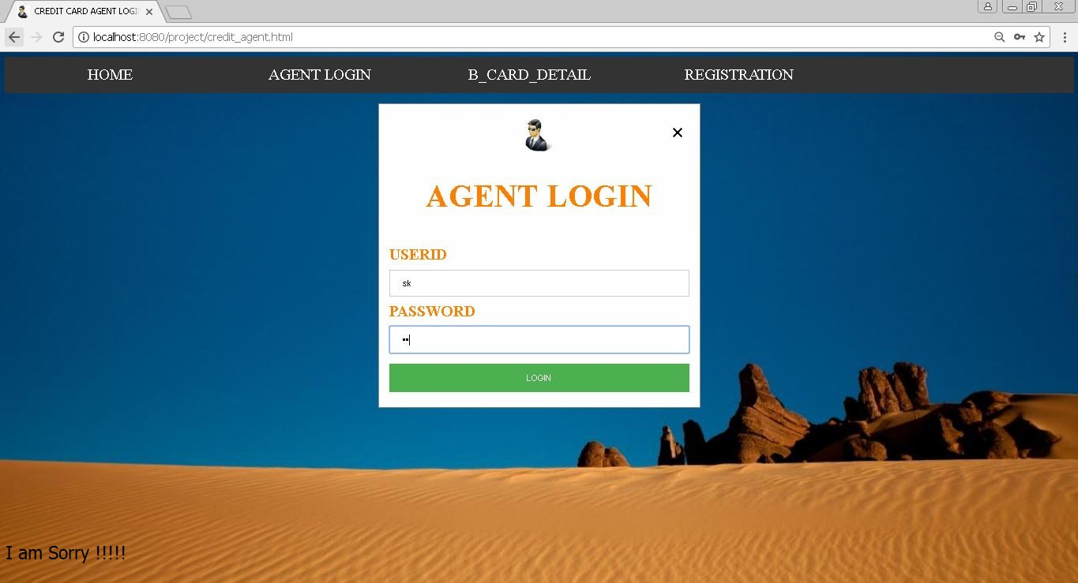

Slide 17
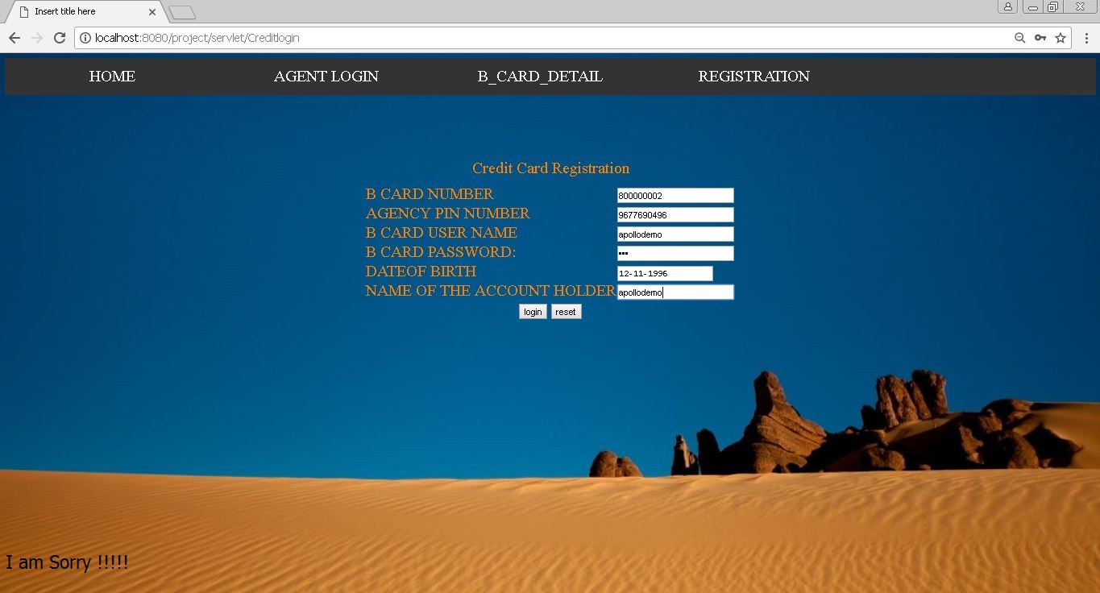

Slide 18
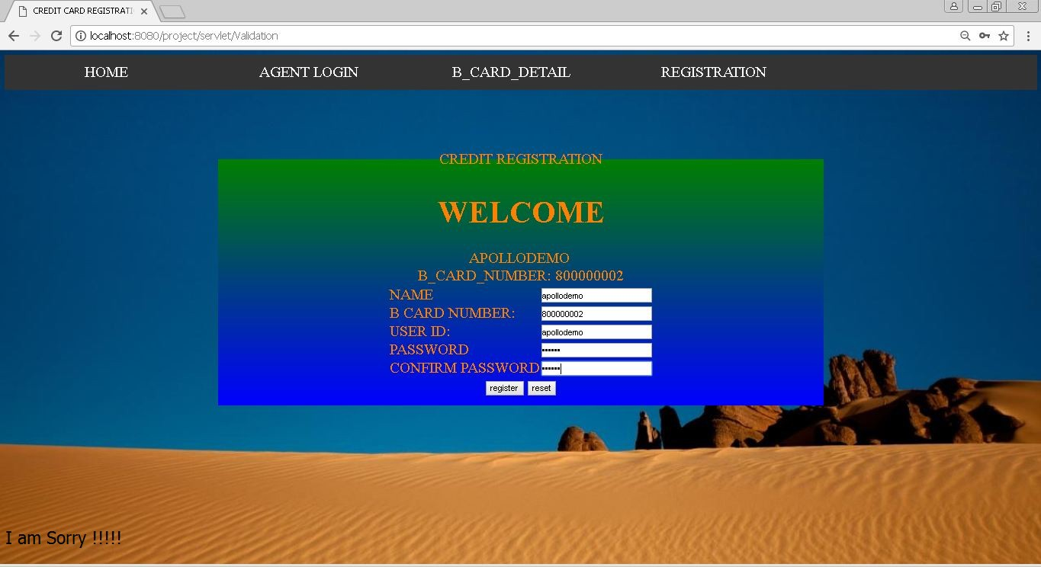

Slide 19
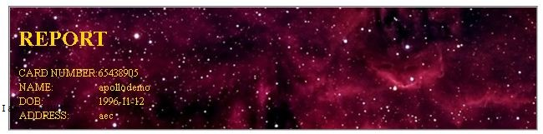

Slide 20
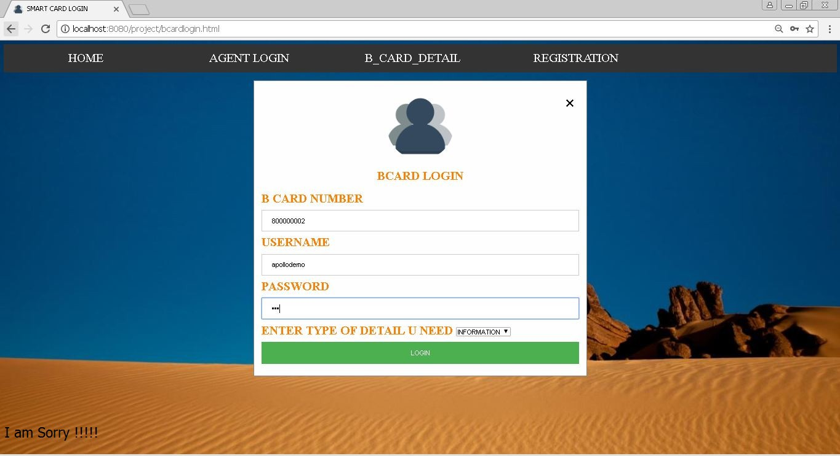

Slide 21
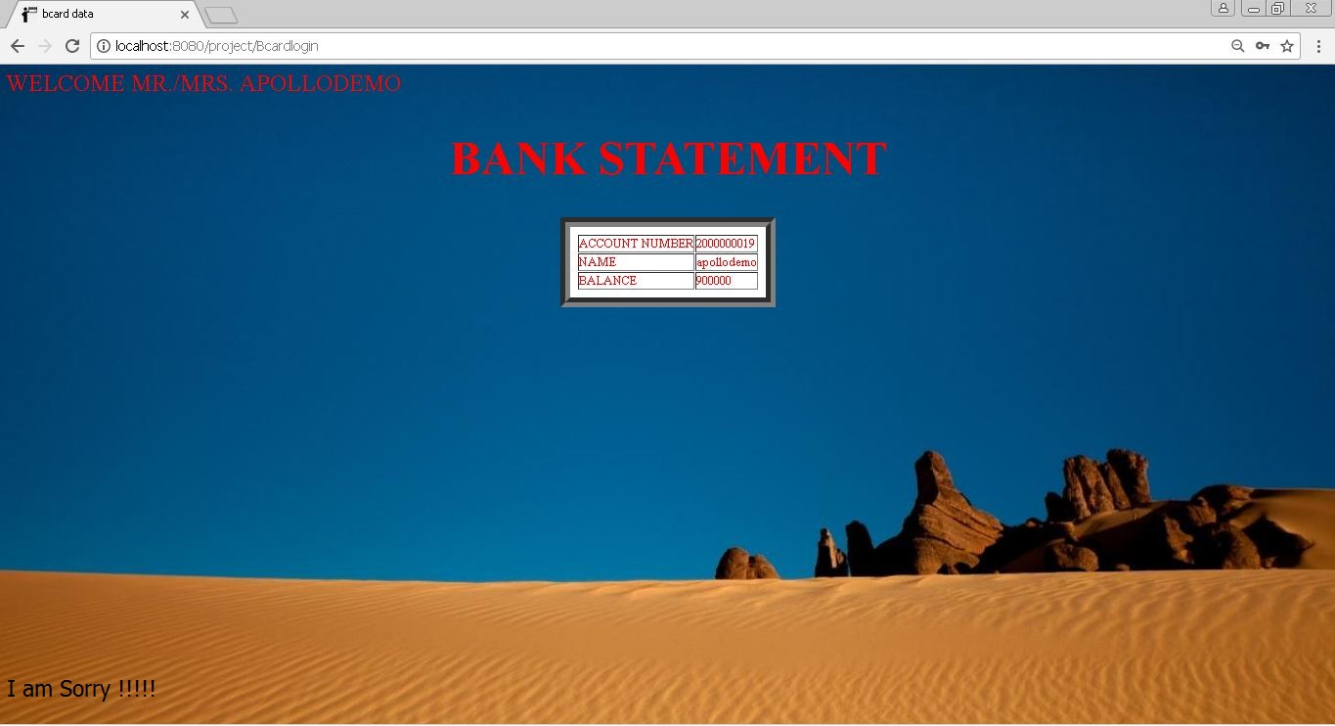

Slide 22
FUTURE ENHANCEMENT
In the future plan for the system is concentration on the medical field. If the patient admits in serious condition at this condition doctor have previous medical report that useful to the doctor further treatment suddenly.
The people information’s are the maintain in the database with high firewall security over the internet.
The smart card information’s are get by the public key exchange technique.

Slide 23
DOMAIN EXPLANATION
The cards information are store into the big data. The data of the customers extracting from database by the DATA MINING algorithms
Association rule using for mining the data from the data ware house.
The each customers data in the database will be get by the single number.

